Slide 1
Why you should use Tumbleweed
Rolling release made easy
Efstathios Iosifidis
iosifidis@opensuse.org

Slide 2


Rock & Roll

Slide 3
openSUSE Tumbleweed
Built correctly
Tested well
Delivered quickly
Trusted more and more

Slide 4
Built correctly
Built together as a cohesive distribution
If a new package checked in that potentially can invalidate another package, then the dependant packages are rebuilt.
Traditional distributions take days, we do it in hours
Open Build Service (http://build.opensuse.org/)
This produces a ‘snapshot’. Traditional distribution call this a ‘release candidate’.
Tumbleweed does it about 5 times a week

Slide 5
Tested Well
But building is only half the story. A good distribution needs to be tested.
Arch and Gentoo rely on manual testers.
openSUSE has openQA
Before any human, openQA tests that snapshot over 100 times across four different hardware architectures (i586, x86_64, ppc64, and aarch64)
openQA actually does proper real-world scenarios. Installations, upgrades, dual booting, encrypted LVM, kde, gnome, xfce, live CD’s, network installs.

Slide 6
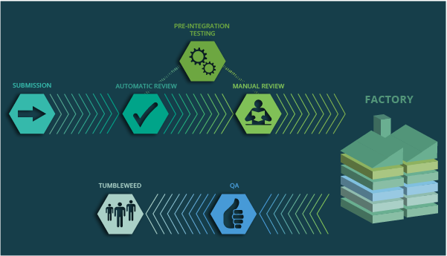
Tested Well

Slide 7
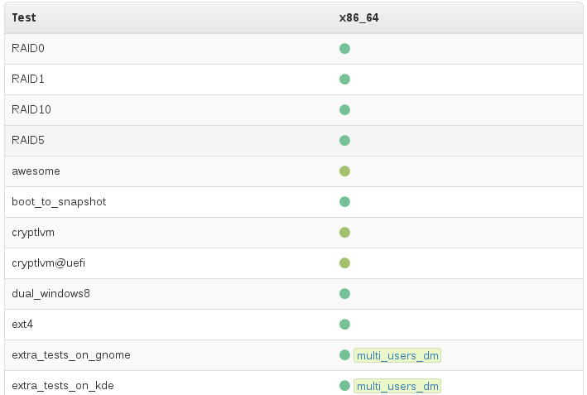
openQA results

Slide 8
Tested Well
So every test checks that every screen looks the way we want it to look for users.
Every function that is tested presses the same keys and clicks on the same mouse buttons that a user would, and then openQA confirms that piece of software behaves in the way it has been taught to expect.
openQA does this for every step in installations & upgrades.

Slide 9
Tested Well
We even do extra testing on incoming package submissions, so many cases we catch things before they get anywhere near a snapshot, and our developers get nice fast feedback about their otherwise potentially destructive change.
Yes, we have implemented Continuous Integration for distributions, and if you were using OBS and openQA you could be doing it too.
https://openqa.opensuse.org/

Slide 10
Delivered Quickly
1000’s of tests, over 100 scenarios…and with our current hardware (thanks SUSE!) a full snapshot gets tested in about 3 hours.
And IF IT PASSES, it ships, automatically.
And a ‘quiet’ week can consist of approx new/updated 150 packages and a new kernel...
A normal week is double, if not triple that, and it’s moving faster and faster...

Slide 11
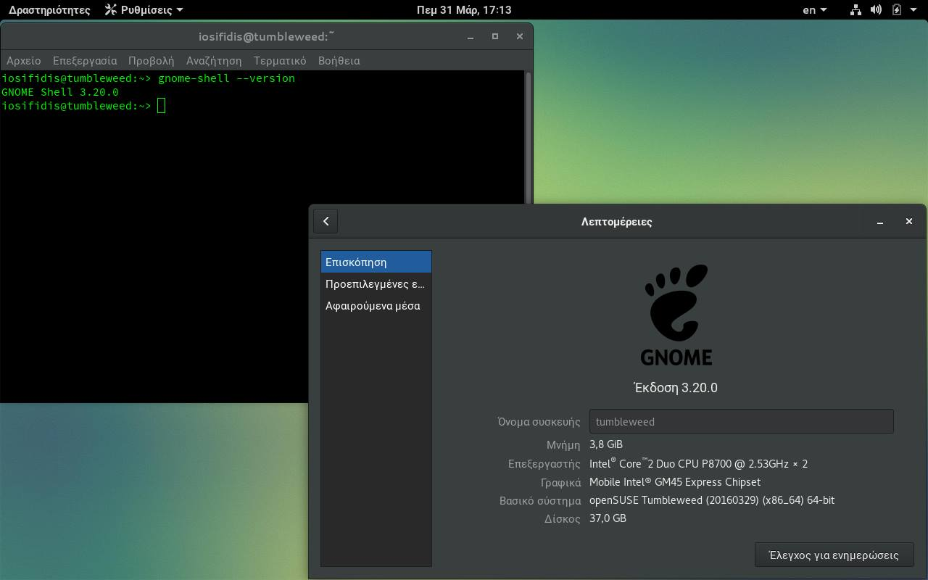
GNOME 3.20 released on March 23rd

Slide 12
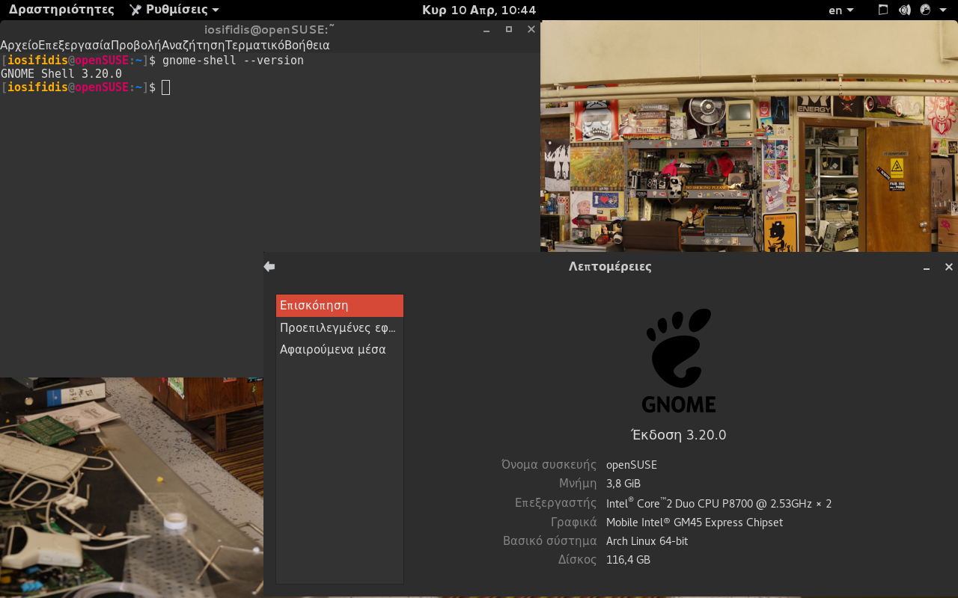
GNOME 3.20 released on March 23rd

Slide 13
Delivered Quickly
That’s not universally true though, good testing finds bugs, those bugs need to be fixed, so if you ever notice something taking longer than you’d like, it’s often a sign that we could do with more contributors helping Package that particular software.
You can contribute to Tumbleweed even as end user.

Slide 14
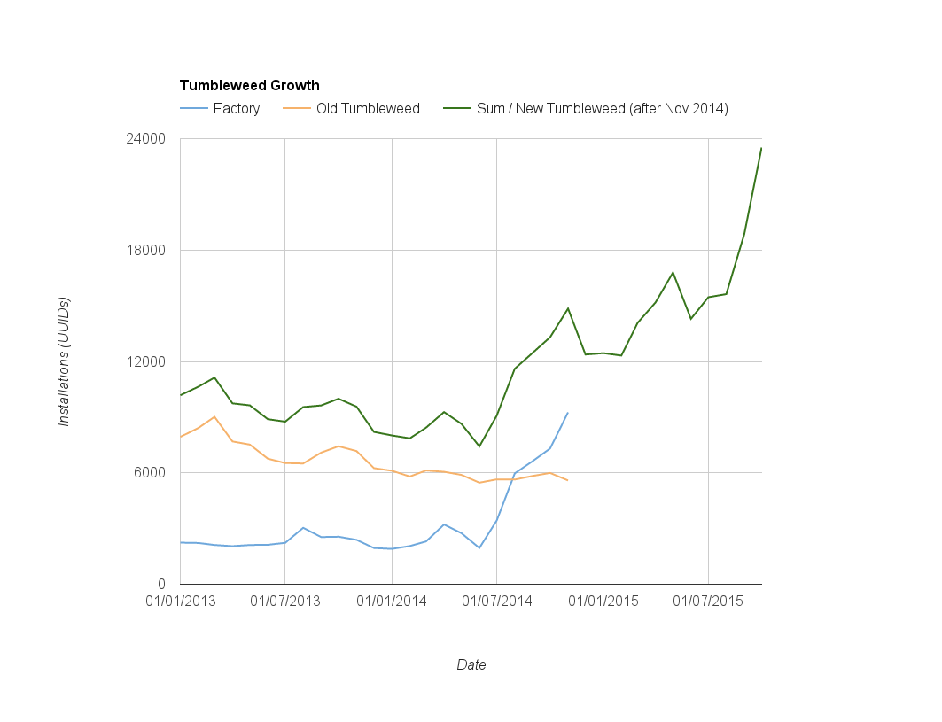
Trusted by More and More

Slide 15
Trusted by More and More
If public numbers are to be believed Tumbleweed might already be larger than ‘more famous’ rolling distributions. Whether or not that’s true doesn’t change one fact - We want YOU to try Tumbleweed.
Companies like SoftIron who ship Tumbleweed on their Overdrive 3000 64-bit ARM servers, and Fujitsu who offer Tumbleweed as their chosen community Linux to customers with Skylake hardware.
If you care about Linux, you want the latest packages, but you only want them when they actually work, Tumbleweed is the best choice.

Slide 16

https://events.opensuse.org/conference/oSC16
June 22 - 26, 2016

Slide 17

https://events.opensuse.org/conference/oSC16

Slide 18
Why you should use Tumbleweed
Questions?
Efstathios Iosifidis
iosifidis@opensuse.org

Slide 19
Join the conversation,
contribute & have a lot of fun!
www.opensuse.org

